Slide 1
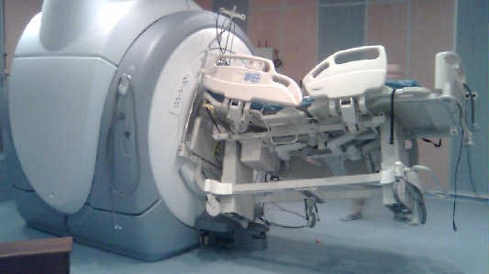

BC Technical Magnet Safety Training Class I

Slide 2
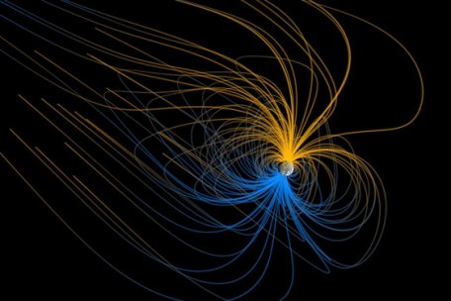
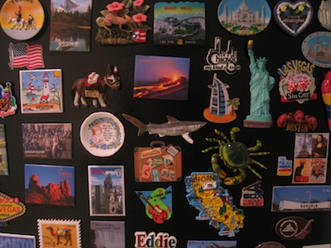
There are many types of MRI magnets with the most common being 1.5 Tesla. In contrast, the earths field is about 30 microtesla and a strong refrigerator magnet is around 5 millitesla.
Earth
Refrigerator Magnets
30 microtesla
5 millitesla

Slide 3
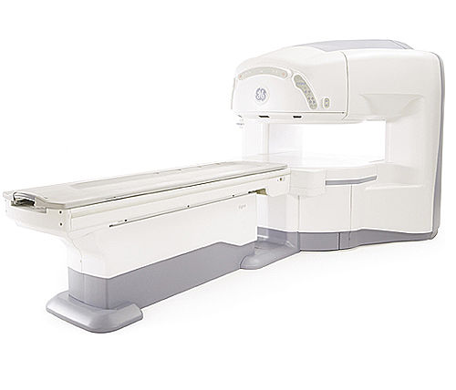
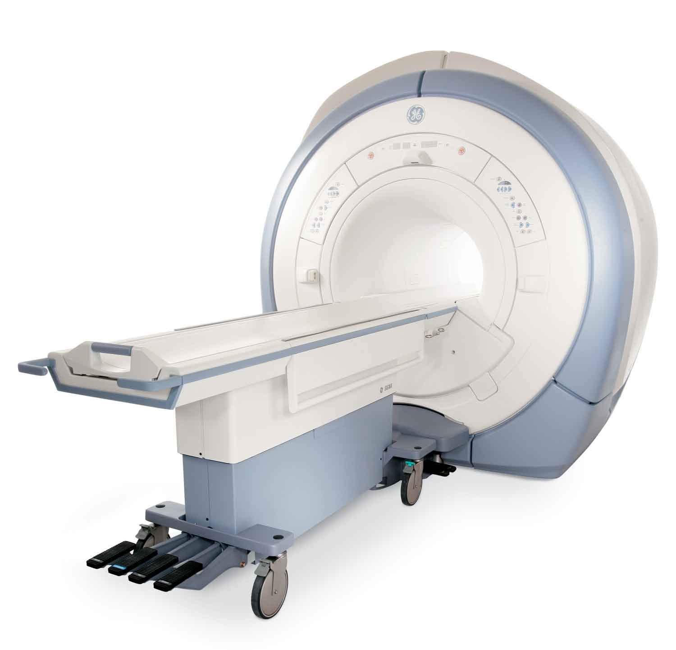
However the field strength alone is not enough to estimate the relative strength of a magnet. Some magnets have active shielding or a reverse magnetic field that reduces the overall external pull of the magnet. Knowing whether or not you have active shielding is not usually apparent. Permanent magnets and open style magnets typically do not have active shielding and the fringe field can be stronger and more dangerous than an active shielded magnet.
.35T Open MRI with NO shielding
<-- = -->
These fringe fields maybe be equal!
1.5T Standard MRI with active shield

Slide 4
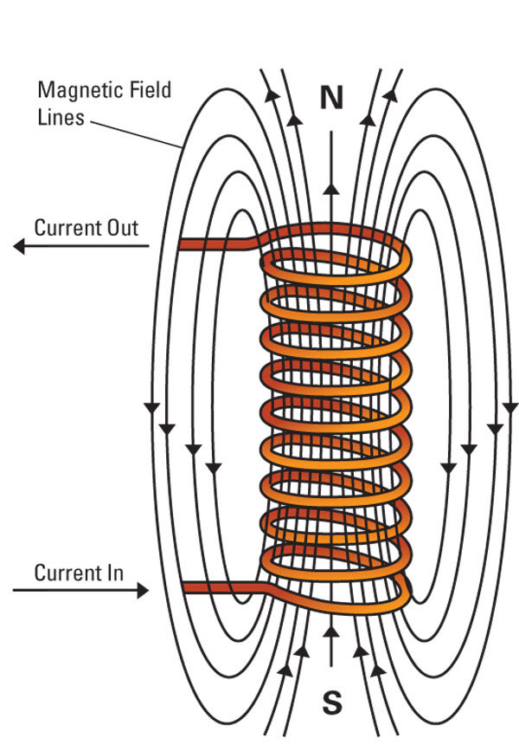
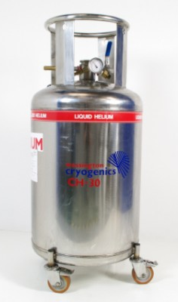
What is an MRI Superconducting Magnet?
A coil winding that is placed in a liquid helium environment with temperatures around 4 Kelvin that has had a current induced into the coil. The coil being in the cryogenic environment allows the coil to have almost zero resistance. Once a current is induced into the magnet the current source can be disconnected from the magnet. This creates an “always on” factor to the MRI magnet 24 hours a day 7 days a week with the magnet at full strength. The magnet is “ramped up” to field one time and stays that way unless some circumstance that causes it to quench or if it’s ramped down, neither of which are typical. Even if the magnetic field is dissipated, there may still be residual fields from magnetized metal or the shim coils inside the magnet.
+
Always treat every MRI machine as being “ON”

Slide 5
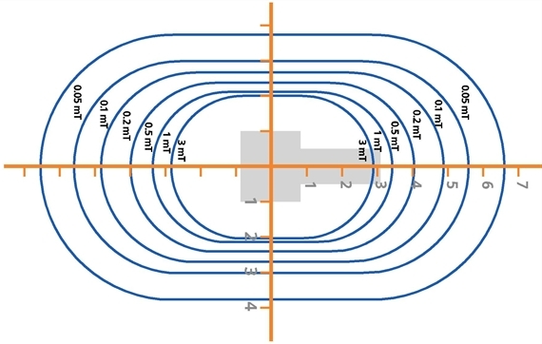
Magnetic Fringe Field
A magnetic fringe field is the magnetic field outside of the bore, or central opening, of the magnet. The magnetic field reduces its field strength by the inverse square law I=1/(d^2), Where ”I” is the intensity and “d” is the distance. So if the intensity at the magnet is I=1/(1^2) or 1 then at twice the distance it’s I=1/(2^2) or 1/4th the intensity and so on. This is an important thing to know and understand because if you have something slightly magnetic at 4 feet away from the magnet it will QUICKLY increase its pull with every inch you move closer. This is true for all magnets.
Side View
This picture is just a general representation and may not be accurate for all magnets

Slide 6
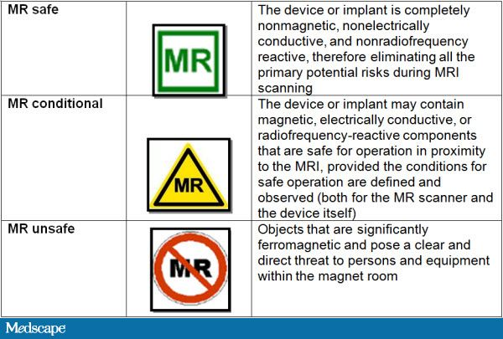
What objects are ferrous?
Anything with iron in it is considered ferrous. A general rule of thumb is that if it rusts it’s ferrous. Steel is the most common metal found in tools and is an alloy of iron. Anything with a motor in it is ferrous. Motors have bearings and a magnet in them.
Watch the following video for the dangers of ferrous items in the scan room. http://www.youtube.com/watch?v=PUdhu9FyYaU If there’s any question as to something being ferrous, use a small magnet to test it first.

Slide 7
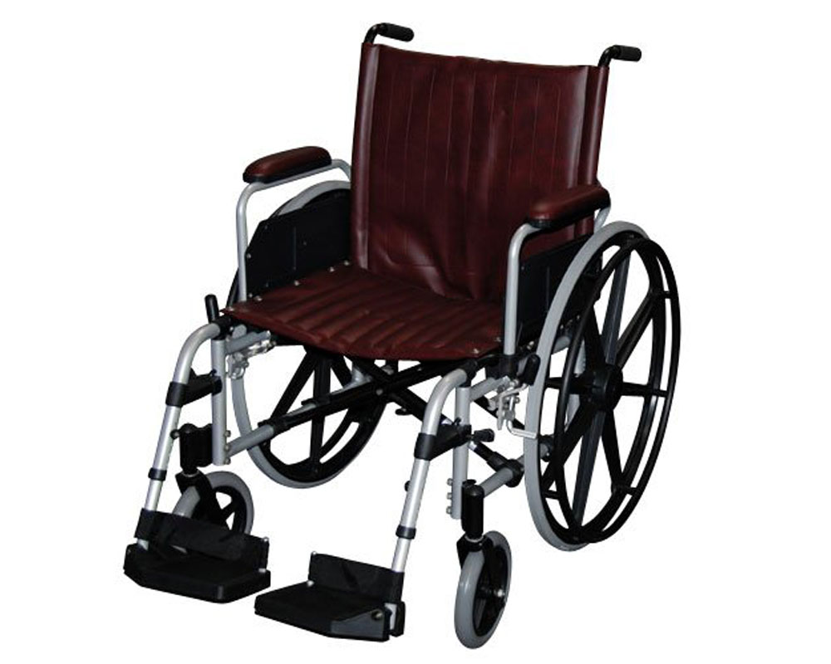
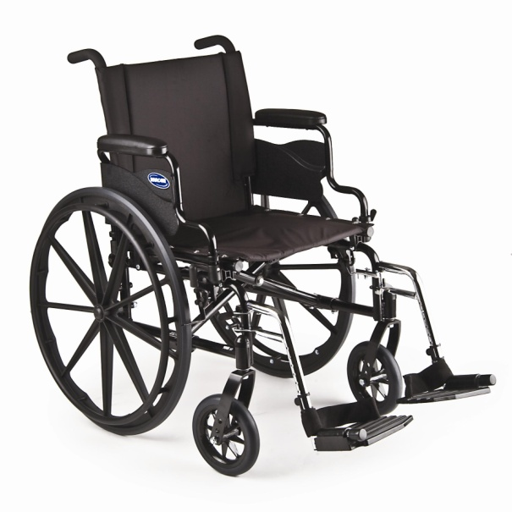
MR Safe Objects
Some objects that are designed to be MR safe have an unsafe counterpart. If there is any question to an objects MR safety, DO NOT USE. Common objects around the MR that have a safe counterpart include wheel chairs, fire extinguishers, oxygen bottles (and caps), patient injectors, step stools, ladders, IV poles, garbage cans, and waiting room chairs. Before using these items make sure they are actually MR safe.
Test any tools before taking them in if there is any question to their metal content.
MR Safe Wheelchair
NOT MR safe Wheelchair
It may be difficult to tell the difference between safe and unsafe objects

Slide 8
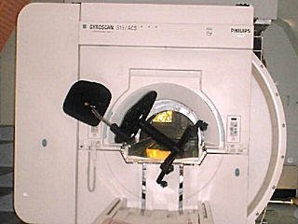
Objects That Are NEVER MR Safe
Office chairs, hospital beds, laptops and tablet computers, staplers, paper clips, anything with rust, metal toolboxes, Canadian coins, and large belt buckles. Steel toe shoes are safe but the pull will be felt when very close to the magnet. Mechanical devices will be destroyed if brought in to the room including analog watches and cameras with shutter mechanisms. Silver and gold are not magnetic but their fake counterparts are.

Slide 9
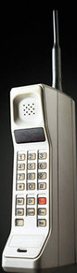
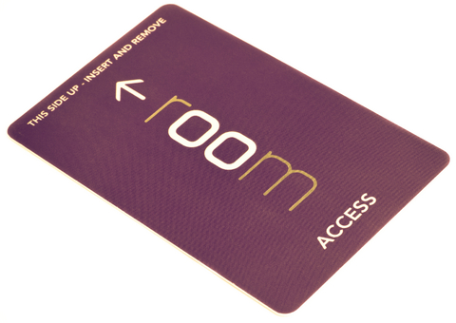
Objects That Can Be Adversely Affected
The magnet erases credit cards and hotel keys, it can deprogram car remotes and keys, temporarily or permanently cause problems with cell phones when close to the magnet, attract Cell phone cameras can be used at the outside walls of the room.

Slide 10

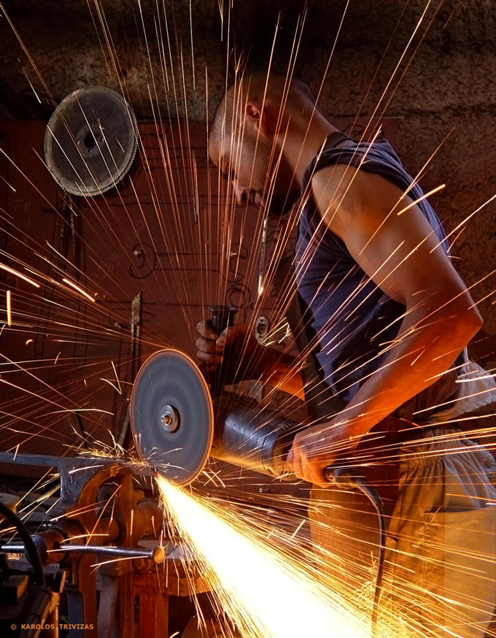
How Might This Affect The Human Body?
If you have an implant of any kind (i.e. aneurism clip, metal screws, pacemaker, etc) you must first check with your doctor before working on an MRI machine. If you have worked around a metal shop you may have metal imbedded in your body. You can be checked for this before working on an MRI by your doctor. Other affects could come from the human physiology reacting to the strong magnetic field. You may experience phosphenes or lights brought on by stimulation of the visual portion of your brain. You could also experience nausea or dizziness from the inner ear reacting with the magnetic field. If you do experience any of these, leave the magnet room and the feelings should pass. Others have had a metallic taste in their mouth while working inside the bore of the magnet.

Slide 11
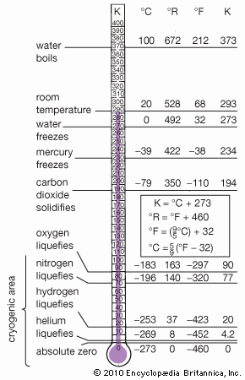
Liquid Helium and Cryogen concerns
Modern MRI superconducting magnets use liquid helium to cool the main winding. Helium becomes liquid at 4.22K or -268.93°C or -452.07°F. At this temperature, there is no resistance in the main coil wire and current is allowed to flow freely without an external source of current. The main issue working with things this cold is contact with your skin. Your skin will be “burned” by the cold after only a few milliseconds of exposure. Cryogen burns cause blisters and potential permanent skin and tissue damage. To prevent this we wear welding gloves and other protective gear.

Slide 12
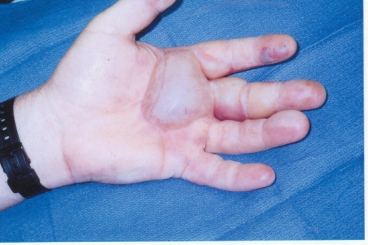
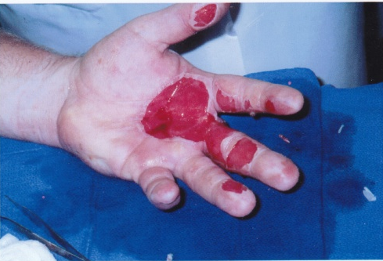
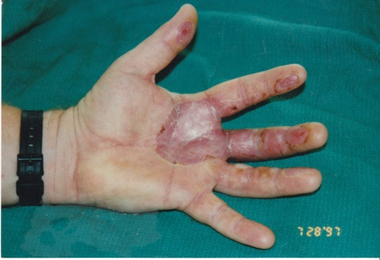
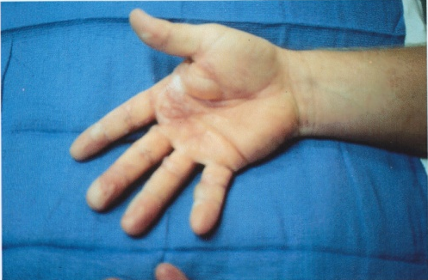
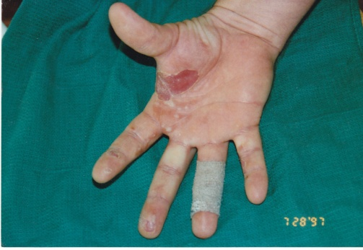
Helium/Frost Burns
Engineer was wearing light weight cotton gloves when fill port was opened under pressure.
Port vented liquid and gaseous helium.
Always wear heavy leather gloves and face shield.

Slide 13
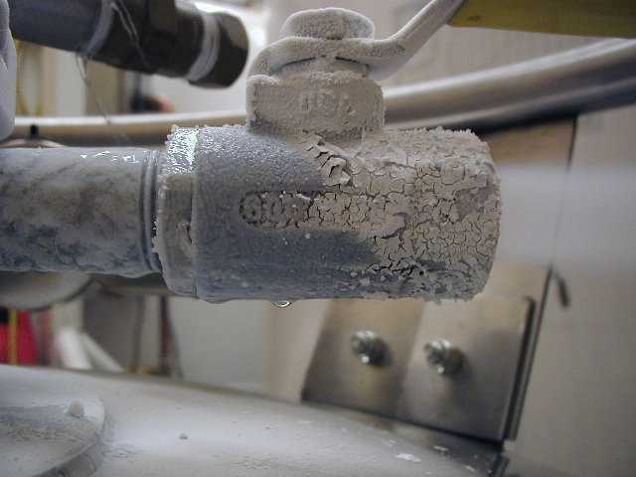
While performing certain duties, you may see liquid forming and dripping off of pipes and other metal components. This is NOT helium. It will be other atmospheric gasses that have liquefied, such as Nitrogen and Oxygen. They will be extremely cold also and can cause burns but more importantly the Oxygen will be flammable. Avoid these areas with open flames and sparks.
Liquid Oxygen and Nitrogen

Slide 14
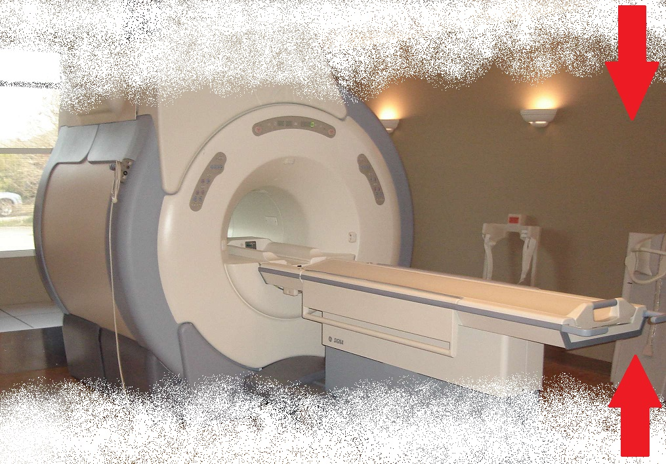
Asphyxiation
Helium is lighter than air, however if there isn’t adequate ventilation in the area you’re working in, it can fill from the top down. If cooling a magnet down, you have the possible exposure to Nitrogen. Nitrogen gas is heavier than air and fills a room from the bottom up. If you lose consciousness from Nitrogen you will fall into a higher concentration of Nitrogen. If no one is around to pull you out you won’t be able to get any oxygen and die.
Helium
Nitrogen

Slide 15
Effects of Oxygen-deficient Atmosphere
19.5-21% Oxygen
Normal oxygen levels in the air we breath, normal body functions
16-19% Oxygen
Air is becoming oxygen-deficient, individual may or may not have noticeable symptoms
12-16% Oxygen
Breathing and pulse rate increased, muscular coordination slightly disturbed
10-14% Oxygen
Emotionally upset, abnormally fatigued and /or disturbed respiration
6-10% Oxygen
Nausea and vomiting, collapse or loss of consciousness
6% and below
Convulsive movements, possible respiratory collapse and death

Slide 16
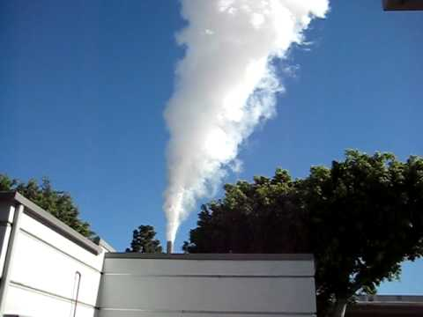
The Quench
The Quenching of a magnet can be intentional and unintentional. When a magnet quenches it can be a violent and dangerous. Taking a few precautions up front can reduce the dangers. Before working on a magnet, it’s a good idea to prop the door open with something heavy like a wooden chair or placing a plastic garbage can in the door jam. In a typical quench, the magnet will release its magnetic field and boil all of the helium into gas which is released through the vent stack at the top of the magnet. The helium will vent into the atmosphere and be totally harmless. The following video is a good example of a routine Quench. http://www.youtube.com/watch?v=9SOUJP5dFEg

Slide 17

Volume of Helium Expands from Liquid to a Gas State
2,000 Liters of liquid helium
Volume = 70 ft³
2,000 Liters of liquid helium in a gas state Volume = 53, 254 ft³
Enclosure Room 10,000 ft³
Enclosure Room 10,000 ft³
Expansion ratio of Helium from a Liquid to a Gas is 1 to 754
Magnet
Magnet
Helium Volume in a liquid state
If the vent pipe is blocked from debris or isn’t connected properly, the magnet will release its helium in the form of gas into the room. The door will be impossible to open until the helium dissipates. There is also typically a vent in the room that has a switch outside of the magnet room, turn that on before any work is done.
Helium Volume in a gas state

Slide 18
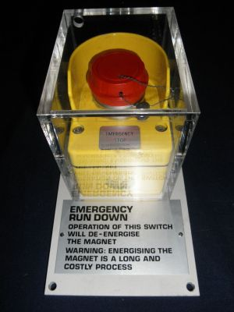
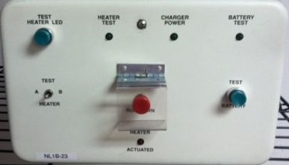
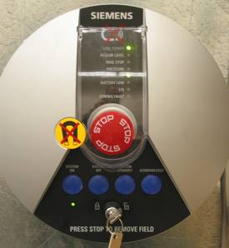
Intentional quenches are done only in emergency situations. If a person is trapped against the magnet and their life is in danger the quench button can be pressed on the magnet rundown unit located somewhere in the MR suite. Be aware that hitting this button will cause upwards of $30,000 for the helium alone and at least a week of downtime for the customer. This button should only be pressed in the direst of circumstance. If the magnet doesn’t quench after hitting the button, immediately call an MR specialist for further instruction.
Intentional Quench
GE ERU/MRU
Siemens ERDU
Philips Quench Button

Slide 19
An unintentional quench can come from internal instability of the magnet, the magnet losing its helium various ways or some sort of warm gas coming in contact with the main coil. This usually happens when no one is around. The technologists should be trained in how to handle this situation and should notify the service engineer immediately upon discovery of a quenched magnet. If you’re working on the magnet and it quenches unintentionally, prior precautions should have been in place to prevent entrapment in the scan room. Leave the room and close the door and allow for the helium to dissipate out the ventilation system. It can take up to 15 min for the helium gas to dissipate from the room. In either case, notify the hospital staff to the situation so they can take the proper action
Unintentional Quench

Slide 20
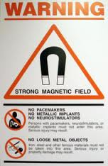
To avoid anyone else being involved in possibly hazardous situations, notify anyone in the area that the procedure you are performing could be dangerous and to not enter the room. If any pedestrians, i.e. techs, hospital CEO, police, etc, try to gain access to the room you have the right to deny them access. As soon as they cross into the magnet room their life could be in danger. The usage of signs and blockades is recommended. There may be some signs to use on site or making your own sign is ok.
Take Charge!

Slide 21
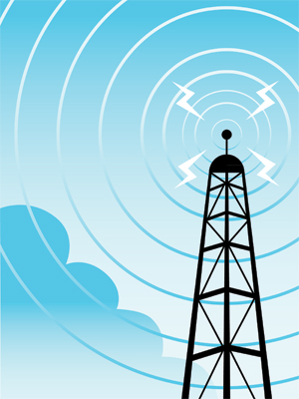
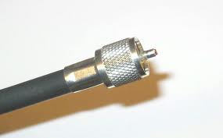
RF Overview
The MR system uses RF energy to gain information from the human body. The power used in a 1.5T system can be up to 20 kilowatts. AM radio stations ranges from about 250 to 50,000 watts. As you can see, the 1.5T MR RF amplifier has enough power for a medium AM radio station. At that power, removing the Heliax, or special RF coaxial cables, from the amplifier while it’s on could severely injure you or even kill. While being scanned, patients have gotten RF burns on various parts of their bodies while making contact with the RF body coil. Patients have also experienced peripheral stimulation or a tingling or buzzing feeling in their arms or legs. This can be prevented by not crossing your arms or legs
Heliax

Slide 22
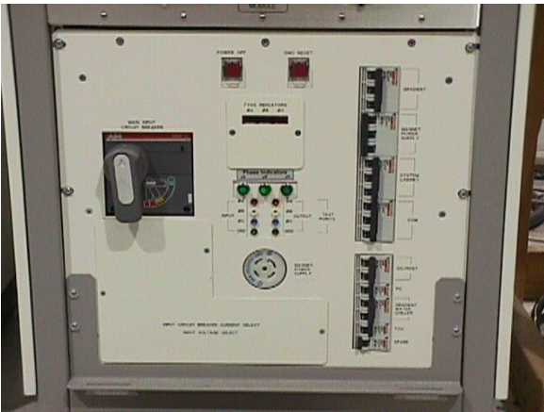
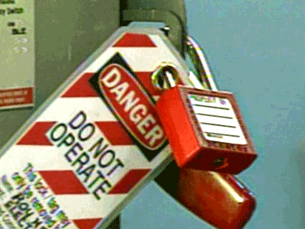
High Voltage Sources
The MR system uses 3phase 480 volt power. The power comes into the system via a main disconnect panel and then is fed to the PDU. The PDU splits up the power into various other voltages for use on the system. Use proper Lock out/ Tag out procedures when working on these components. LOTO hasp connections are available on both the PDU and the main disconnect.
If working with an MR engineer that is ramping a magnet up or down, be aware that at the rear of the ramp supply there is up to 1000 amps of power exposed at any given time during the procedure.
If an electrocution does occur, dial 911 and notify someone in the vicinity to get help. Secure the site from the danger.
GE PDU
LOTO

Slide 23
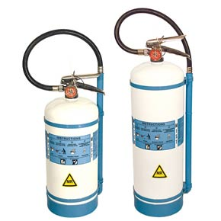
Fire Response
If a fire occurs outside of the magnet room, follow regular procedures to contain the fire. Notify staff and pull the fire alarm. If a fire occurs inside of the magnet room, be sure to only use MR safe fire extinguishers. Pull the fire alarm but beware that the fire suppression system may release gases or chemicals designed to suffocate a fire. Also, notify the staff and follow their procedures. Make people aware of the magnet.

